Slide 1
Stock market analysis

Slide 2
ABOUT project
This task focused on analyzing and comparing the stock market performance of Apple, Microsoft, Netflix, and Google using a three-month historical dataset. The goal was to identify key trends, patterns, and relationships through a structured data science approach. The methodology included calculating moving averages to identify trends, determining volatility to assess risk, and performing correlation analysis to understand the co-movement between the different stocks. The results provide a clear, quantitative comparison of each company's performance characteristics and their relational dynamics within the tech sector.

Slide 3
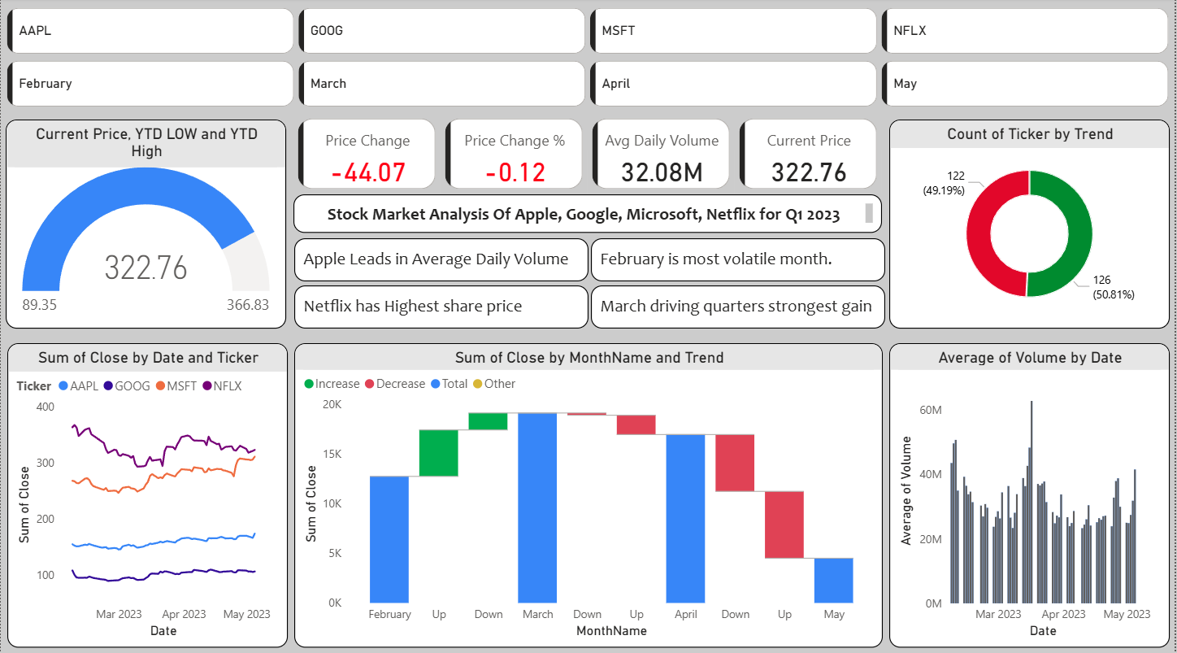
Power BI dashboard overview

Slide 4
Line Chart - Price Trend
Gauge Chart
The line chart is the best way to visualize the trend and movement of a stock's closing price over time. It clearly shows upward, downward, or sideways momentum. Adding the Ticker to the Legend allows you to compare multiple stocks on the same graph.
This gives a fantastic quick-glance performance indicator. The needle shows how close the current price is to its yearly high. If the needle is near the top (green), the stock is performing very well. If it's near the bottom (red), it's near its lows.
Bar Chart - Daily Volume
Waterfall Chart
A bar chart is ideal for comparing quantities across categories (each day is a category). It effectively shows spikes in trading volume, which often correspond to important news or price movements, providing context to the price trend above it.
This chart is perfect for understanding what drove the net change over a period. It shows each period (e.g., each month) as a bar that either increases or decreases the total, starting from the first price and ending on the last. It visually breaks down which months were the biggest contributors to gains or losses.
Donut Chart
This provides a quick, at-a-glance view of market sentiment. The proportion of green ("Up") to red ("Down") slices instantly tells you if the selected period was mostly bullish or bearish for the stock.

Slide 5
Project OVERVIEW
Overview:
This interactive analysis tracks the performance of a select technology portfolio from February to May 2023. The dashboard is designed to answer three key questions: What is the current status? What has been the historical trend? And what was the market's daily behavior?
Key Insights from the Data:
Market Recovery: The portfolio experienced a significant upward trajectory in mid-March, with most stocks recovering from their Q1 lows and testing new yearly highs by April.
Sector Divergence: Not all tech stocks moved in lockstep. [You could insert a specific example here, e.g., "While AAPL and MSFT showed steady growth, NFLX demonstrated higher volatility."]
Volume-Price Correlation: Major price moves were often confirmed by spikes in trading volume (visible in the Volume chart), indicating strong institutional interest.
Prevailing Sentiment: The 'Market Sentiment' donut chart reveals that bullish (green) days outnumbered bearish (red) days for most tickers during this period, confirming a positive underlying trend.

